Slide 1

Real State In Atlanta Metro Area – Price Trends
Project 1
Karem Olavarri
Juan Gonzalez
Jensen Binoji
Carlos Aizpurua

Slide 2

Motivation
“Atlanta had the lowest median house price among the 10 fastest-growing metro areas, yet it had the fifth-highest household income. The combination of good wages and low house prices put Atlanta at the top for house affordability. It added 89,013 people in 12 months, making it the third-fastest-growing metro”
Project Objective:
To understand how key demographic parameters are linked to house prices in Atlanta Metropolitan Area.
http://www.covingtonleader.com/business/home-affordability-watch-the-fastest-growing-metro-areas/article_8d17a851-1e31-51a5-89b1-62f9ff147fa2.html

Slide 3
Questions to Answer
How Atlanta’s median house price compare to other fast-growing metro areas in the US.
Does location in the Atlanta metro area (County) have a direct impact in house pricing? What is the reality within the metro area?
How prices have change since 2010?
Is this trend related to population growth?
How per capital income correlates to house prices?
Is population increasing in the suburbs? How is this affecting house prices?

Slide 4
Data Clean Up
House pricing data from Zillow and Census API had available records for all across the United States. This includes house pricing by zip codes, counties, cities and states.
For this analysis we filtered the data by counties in the Atlanta Metro Area.
The Atlanta Metro Areas comprises 19 counties
Barrow
Bartow
Carroll
Cherokee
Clayton
Cobb
Coweta
Dawson
Dekalb
Douglas
Fayette
Fulton
Forsyth
Gwinnet
Henry
Lamar
Meriwether
Pickens
Walton

Slide 5


Data Sources and Data Exploration
For this analysis we looked into demographic data provided by the Census API. From this API we pulled parameters such as population, median age, household income, per capital income, median value housing units and poverty count.
In combination with census API we pull data from Zillow datasets. Zillow provides a series of CSV files with time series data on house pricing by different categories.

Slide 6
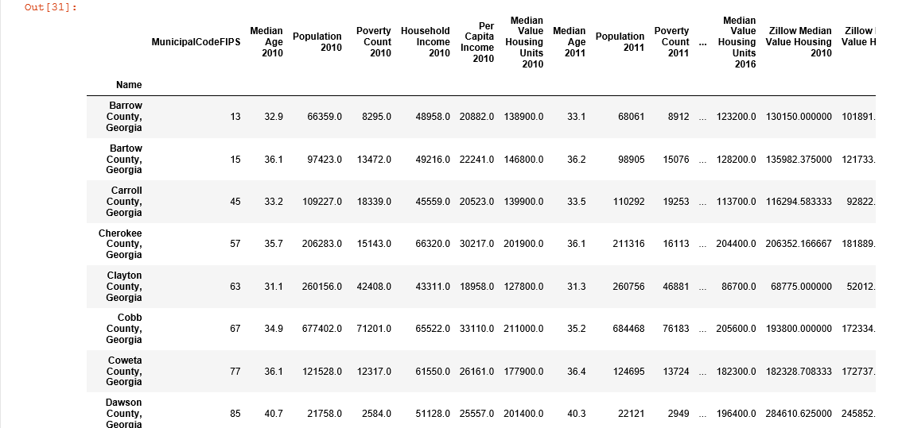
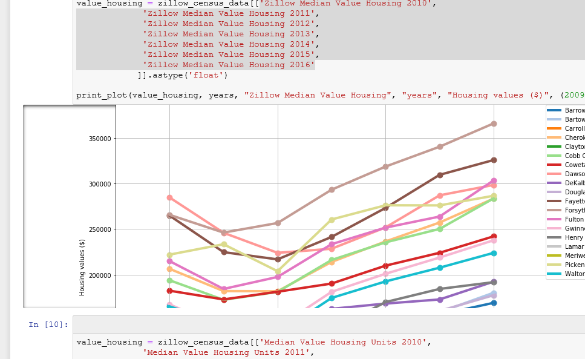
Data Analysis
Let’s look at the jupyter notebook!!
I would suggest Juan to go through this step. He was the master of the script

Slide 7
How Atlanta’s median house price compare to other fast-growing metro areas in the US?
Metro Area | Median House Price 2018
Atlanta | 244,466$
Houston | 293,064$
Dallas | 298,371$
Washington, DC | 421,974$
Austin | 291,780$
Tampa | 260,600$
Phoenix | 265,000$
Orlando | 282,947$
Riverside | 723,347$
Seattle | 490,000$
Atlanta is one of the three fastest growing metropolitan areas with relatively affordable home prices!!

Slide 8
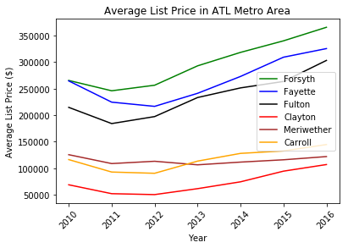
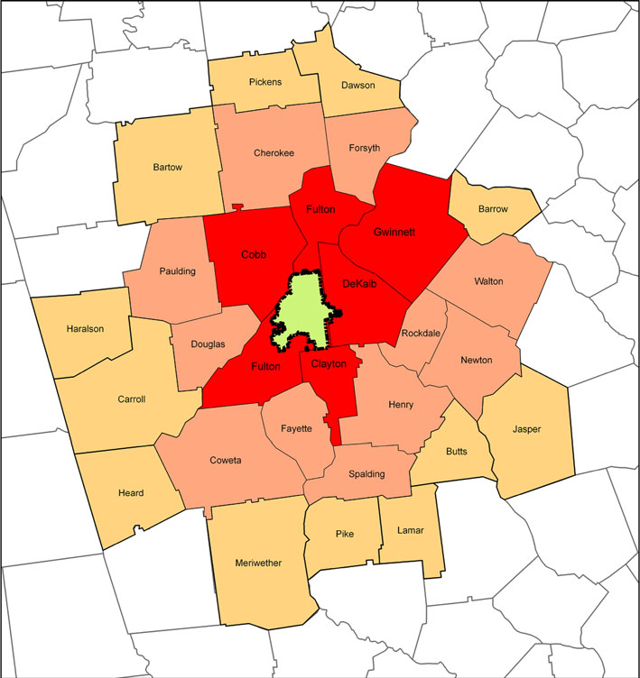
Location in the metro area
Does location in the Atlanta metro area (County) have a direct impact in house pricing?

Slide 9
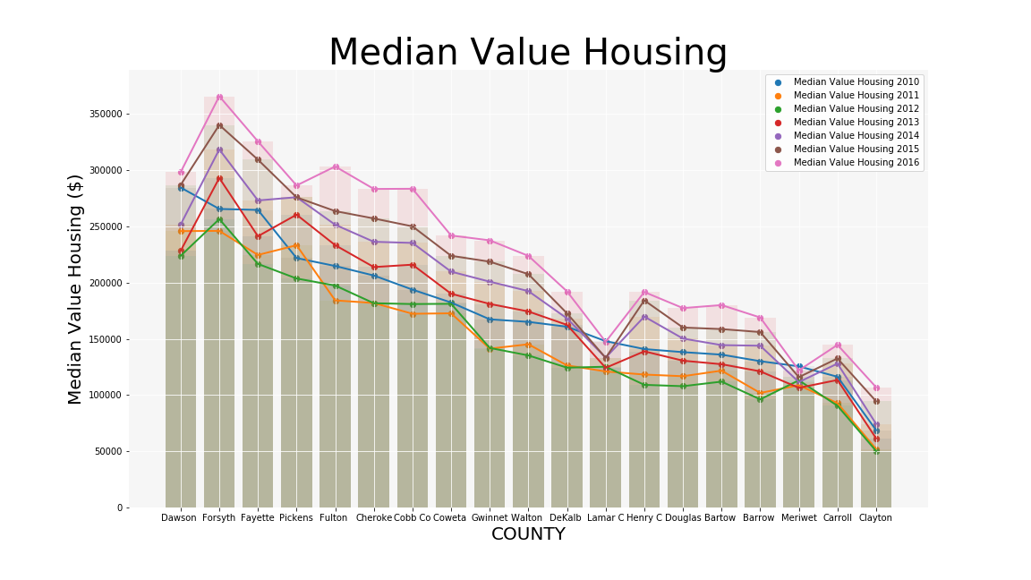
How prices have change since 2010?
Picture here

Slide 10
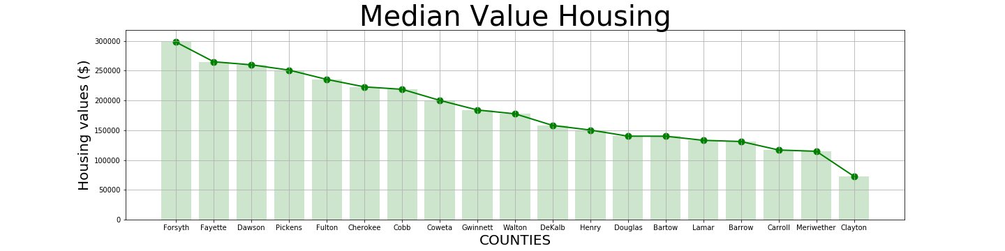
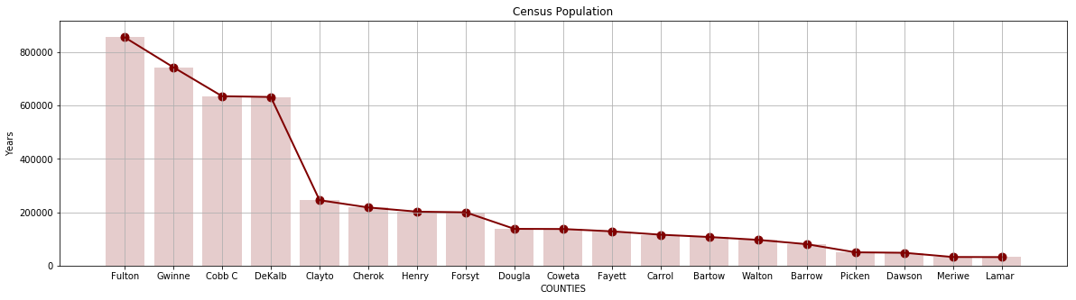
How population by county could impact house prices?

Slide 11
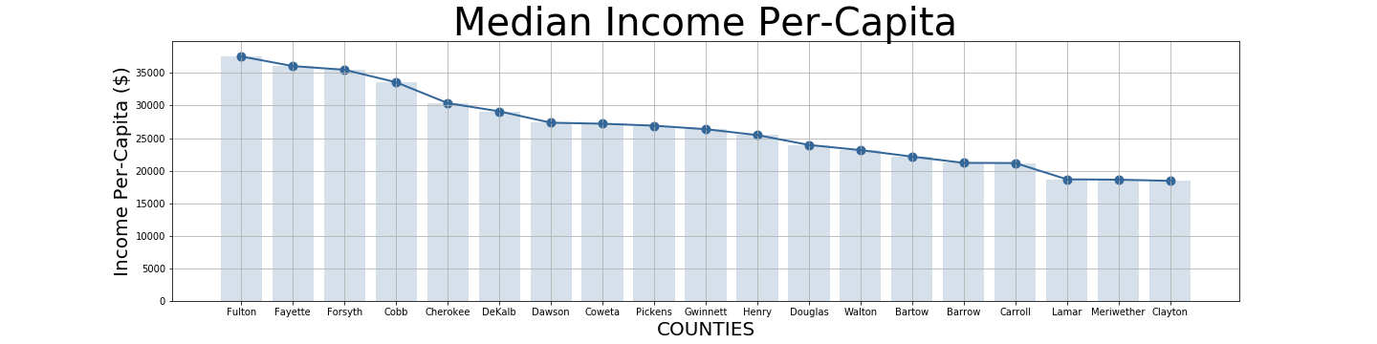
How per capital income correlates to house prices?

Slide 12
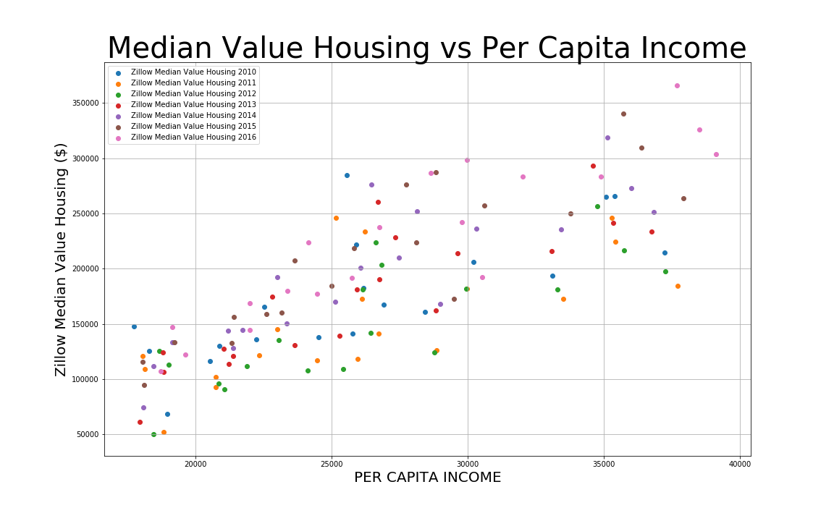
How per capital income correlates to house prices?

Slide 13
Summary
Results where as expected. However, we hoped we would be able to identify a trend between how population has evolved in the Atlanta metro area over the time. However we needed additional data points in order to find actual relationships.
We believe that more research needs to be done. Maybe using other indicators
From this data we can infer that house prices will continue to grow as the metro area keeps positioning as a city with attractive salaries.
PLEASE ADD MORE HERE BASED ON YOUR PLOTS

Slide 14
Post Mortem
We wanted to look for additional correlations such as type of House and its characteristics (1, 2 or 3 bedrooms, garage, lot, etc) but the data was not available in our sources.
Similar information was found but the data corresponded to house pricing in Ames, Iowa. A possible assumption we wanted to use, was to identify correlations between house characteristics using such data then calculate an adjustment factor based different city (something similar to scaling factors).
We contacted people on SimplyRETS (real state API) but they did not reach out until yesterday.

